Slide 1
CASCADING STYLE SHEET [CSS] Version 3

Slide 2
CSS DEVELOPMENT ENVIRONMENT
Visual Studio Code
VS Code Extension (CSS Peek, CSS Snippets, Colorize)
CSS Libraries / Components

Slide 3
CSS ARCHITECTURE
CSS architecture refers to the design patterns, naming conventions, and organization methods used to manage CSS code in a scalable and maintainable way.
Good CSS architecture helps manage the complexity and scope of styles as projects grow.

Slide 4
CSS ARCHITECTURE [Methodologies]
BEM (Block Element Modifier):
Block: A standalone entity that is meaningful on its own (e.g., .button).
Element: A part of a block that has no standalone meaning and is semantically tied to its block (e.g., .button__icon).
Modifier: A flag on a block or element that changes its appearance or behavior (e.g., .button--large).

Slide 5
CSS ARCHITECTURE [Methodologies]
Example: Applying BEM Methodology
/* Block: card */
.card {
background-color: white;
border-radius: 5px;
box-shadow: 0 2px 5px rgba(0, 0, 0, 0.1);
padding: 20px; margin: 20px 0;
}
/* Element: card__header */
.card__header {
font-size: 1.5em;
margin-bottom: 10px;
}
/* Modifier: card--featured */
.card--featured { border: 2px solid #007bff; }

Slide 6
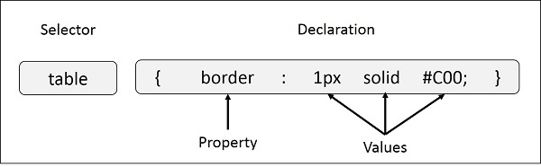
CSS SYNTAX
Selector − A selector is an HTML tag at which a style will be applied. This could be any tag like <h1> or <table> etc.
Property − A property is a type of attribute of HTML tag. Put simply, all the HTML attributes are converted into CSS properties. They could be color, border etc.
Value − Values are assigned to properties. For example, color property can have value either red or #F1F1F1 etc.
selector { property: value }

Slide 7
CSS Implementation
There are three ways to insert CSS in HTML documents.
Inline CSS
Internal CSS
External CSS
Inline CSS
Inline CSS is used to apply CSS on a single line or element.
For example:
<p style="color:blue">Hello CSS</p>
Internal CSS
Internal CSS is used to apply CSS on a single document or page. It can affect all the elements of the page. It is written inside the style tag within head section of html.
For example:
<style>
p{color:blue}
</style>

Slide 8
CSS Implementation
External CSS
External CSS is used to apply CSS on multiple pages or all pages. Here, we write all the CSS code in a css file. Its extension must be .css for example style.css.
For example:
p{color:blue}
You need to link this style.css file to your html pages like this:
<link rel="stylesheet" type="text/css" href="style.css">

Slide 9
CSS Selector
CSS selectors are used to select the content you want to style. Selectors are the part of CSS rule set. CSS selectors select HTML elements according to its id, class, type, attribute etc.
There are several different types of selectors in CSS.
CSS Element Selector
CSS Id Selector
CSS Class Selector
CSS Universal Selector
CSS Group Selector

Slide 10
CSS Selector
CSS Element Selector
The element selector selects the HTML element by name.
<!DOCTYPE html>
<html>
<head>
<style>
p{
text-align: center;
color: blue;
}
</style>
</head>
<body>
<p>This style will be applied on every paragraph.</p>
<p id="para1">Me too!</p>
<p>And me!</p>
</body>
</html>

Slide 11
CSS Selector
CSS ID Selector
The id selector selects the id attribute of an HTML element to select a specific element. An id is always unique within the page so it is chosen to select a single, unique element.
It is written with the hash character (#), followed by the id of the element.
<!DOCTYPE html>
<html>
<head>
<style>
#para1 {
text-align: center;
color: blue;
}
</style>
</head>
<body>
<p id="para1">Hello Javatpoint.com</p>
<p>This paragraph will not be affected.</p>
</body>
</html>

Slide 12
CSS Selector
CSS Class Selector
The class selector selects HTML elements with a specific class attribute. It is used with a period character . (full stop symbol) followed by the class name.
Note: A class name should not be started with a number.
<!DOCTYPE html>
<html>
<head>
<style>
.center {
text-align: center;
color: blue;
}
</style>
</head>
<body>
<h1 class="center">This heading is blue and center-aligned.</h1>
<p class="center">This paragraph is blue and center-aligned.</p>
</body>
</html>

Slide 13
CSS Selector
CSS Universal Selector
The universal selector is used as a wildcard character. It selects all the elements on the pages.
<!DOCTYPE html>
<html>
<head>
<style>
* {
color: green;
font-size: 20px;
}
</style>
</head>
<body>
<h2>This is heading</h2>
<p>This style will be applied on every paragraph.</p>
<p id="para1">Me too!</p>
<p>And me!</p>
</body>
</html>

Slide 14
CSS Selector
CSS Group Selector
The grouping selector is used to select all the elements with the same style definitions.
Grouping selector is used to minimize the code. Commas are used to separate each selector in grouping.
Let's see the full example of CSS group selector.
<!DOCTYPE html>
<html>
<head>
<style>
h1, h2, p {
text-align: center;
color: blue;
}
</style>
</head>
<body>
<h1>Hello Javatpoint.com</h1>
<h2>Hello Javatpoint.com (In smaller font)</h2>
<p>This is a paragraph.</p>
</body>
</html>

Slide 15
CSS Background
CSS background property is used to define the background effects on element. There are 5 CSS background properties that affects the HTML elements:
background-color
background-image
background-repeat
background-attachment
background-position
Background Color
body { background-color: #f0e68c; }
Background Image
body { background-image: url("images/tile.png"); }

Slide 16
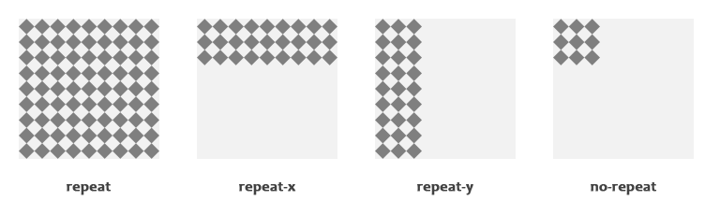
CSS Background
Background Repeat
body { background-image: url("images/gradient.png");
background-repeat: repeat-x; }
body { background-image: url("images/texture.png");
background-repeat: no-repeat; }

Slide 17
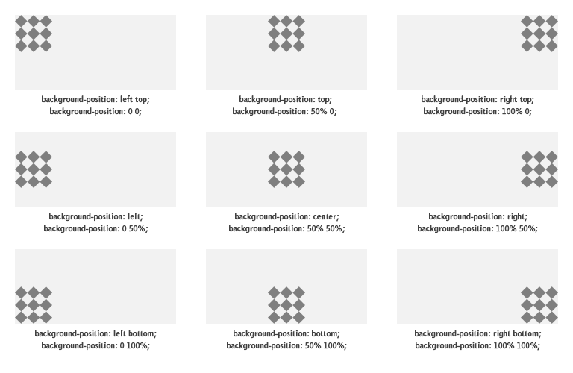
CSS Background
Background Position
body { background-image: url("images/robot.png");
background-repeat: no-repeat;
background-position: right top; }

Slide 18
CSS Background
Background Attachment
body { background-image: url("images/bell.png");
background-repeat: no-repeat;
background-attachment: fixed; }
The Background Shorthand Property
body { background-color: #f0e68c;
background-image: url("images/smiley.png");
background-repeat: no-repeat;
background-attachment: fixed;
background-position: 250px 25px; }

Slide 19
CSS Color
The color property defines the text color (foreground color in general) of an element.
body { color: #ff5722; }
Defining Color Values
Colors in CSS most often specified in the following formats:
a color keyword - like "red", "green", "blue", "transparent", etc.
a HEX value - like "#ff0000", "#00ff00", etc.
an RGB value - like "rgb(255, 0, 0)"

Slide 20
CSS Border
CSS Border Properties
The CSS border properties allow you to define the border area of an element's box.
Borders appear directly between the margin and padding of an element. The border can either be a predefined style like, solid line, dotted line, double line, etc.
Understanding the Different Border Styles
The border-style property can have the following values: none, hidden, solid, dashed, dotted, double, inset, outset, groove, and ridge.
None
Hidden
Solid
Dashed
Dotted
Double
Inset
Outset
Groove
Ridge

Slide 21
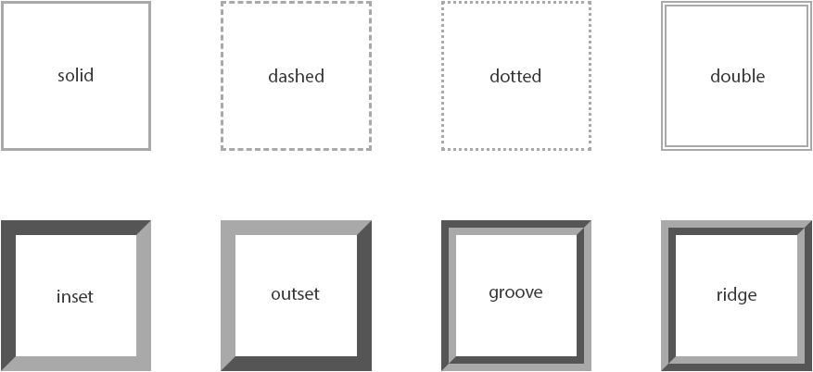
CSS Border
CSS Border Properties

Slide 22
CSS Border
CSS Border Properties
Setting the Border Width
p {
border-style: dashed;
border-width: 10px;
}
Specifying the Border Color
p {
border-style: solid;
border-color: #ff0000;
}
The Border Shorthand Property
p {
border: 5px solid #00ff00;
}

Slide 23
CSS Border
CSS Border Properties
Creating CSS3 Rounded Corners
The border-radius property can be used to create rounded corners.
.box {
width: 300px;
height: 150px;
background: #ffb6c1;
border: 2px solid #f08080;
border-radius: 20px;
}

Slide 24
CSS Margin
CSS Margin Properties
The CSS margin properties allow you to set the spacing around the border of an element's box
Setting Margins for Individual Sides
h1 {
margin-top: 50px;
margin-bottom: 100px;
}
p { margin-left: 75px;
margin-right: 75px;
}

Slide 25
CSS Margin
CSS Margin Properties
The Margin Shorthand Property
The margin property is a shorthand property to avoid setting margin of each side separately, i.e., margin-top, margin-right, margin-bottom and margin-left.
h1 { margin: 50px; /* apply to all four sides */ }
p { margin: 25px 75px; /* vertical | horizontal */ }
div { margin: 25px 50px 75px; /* top | horizontal | bottom */ }
hr { margin: 25px 50px 75px 100px; /* top | right | bottom | left */ }

Slide 26
CSS Padding
CSS Padding Properties
The CSS padding properties allow you to set the spacing between the content of an element and its border
Define Paddings for Individual Sides
h1 {
padding-top: 50px;
padding-bottom: 100px;
}
p {
padding-left: 75px;
padding-right: 75px;
}

Slide 27
CSS Padding
CSS Padding Properties
The Padding Shorthand Property
The padding property is a shorthand property to avoid setting padding of each side separately, i.e., padding-top, padding-right, padding-bottom and padding-left.
h1 { padding: 50px; /* apply to all four sides */ }
p { padding: 25px 75px; /* vertical | horizontal */ }
div { padding: 25px 50px 75px; /* top | horizontal | bottom */ }
pre { padding: 25px 50px 75px 100px; /* top | right | bottom | left */ }

Slide 28
CSS Text
CSS Text Properties
Formatting Text with CSS
CSS provides several properties that allows you to define various text styles such as color, alignment, spacing, decoration, transformation, etc. very easily and effectively.
The commonly used text properties are: text-align, text-decoration, text-transform, text-indent, line-height, letter-spacing, word-spacing, and more. These properties give you precise control over the visual appearance of the characters, words & spaces.
Text Color & Alignment
p {
text-align: justify;
color: #434343;
}

Slide 29
CSS Text
CSS Text Properties
Text Decoration
The text-decoration property is used to set or remove decorations from text.
This property typically accepts one of the following values: underline, overline, line-through, and none.
h1 { text-decoration: overline; }
h2 { text-decoration: line-through; }
h3 { text-decoration: underline; }
Text Transformation
The text-transform property is used to set the cases for a text.
h1 { text-transform: uppercase; }
h2 { text-transform: capitalize; }
h3 { text-transform: lowercase; }

Slide 30
CSS Text
CSS Text Properties
Text Indentation
The letter-spacing property is used to set extra spacing between the characters of text.
p { text-indent: 100px; }
Letter Spacing
The letter-spacing property is used to set extra spacing between the characters of text.
h1 { letter-spacing: -3px; }
p { letter-spacing: 10px; }
Word Spacing
The word-spacing property is used to specify additional spacing between the words.
p.normal { word-spacing: 20px; }
p.justified { word-spacing: 20px; text-align: justify; }
p.preformatted { word-spacing: 20px; white-space: pre; }

Slide 31
CSS Font
CSS Font Properties
Styling Fonts with CSS
The font properties are: font-family, font-style, font-weight, font-size, and font-variant.
Font Family
The font-family property is used to specify the font to be used to render the text.
body { font-family: Arial, Helvetica, sans-serif; }
Font Style
The font-style property is used to set the font face style for the text content of an element.
p.normal { font-style: normal; }
p.italic { font-style: italic; }
p.oblique { font-style: oblique; }
Font Size
h1 { font-size: 24px; }
p { font-size: 14px; }

Slide 32
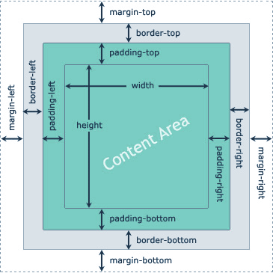
CSS BoxModel
What is Box Model?
Every element that can be displayed on a web page is comprised of one or more rectangular boxes. CSS box model typically describes how these rectangular boxes are laid out on a web page. These boxes can have different properties and can interact with each other in different ways, but every box has a content area and optional surrounding padding, border, and margin areas.

Slide 33
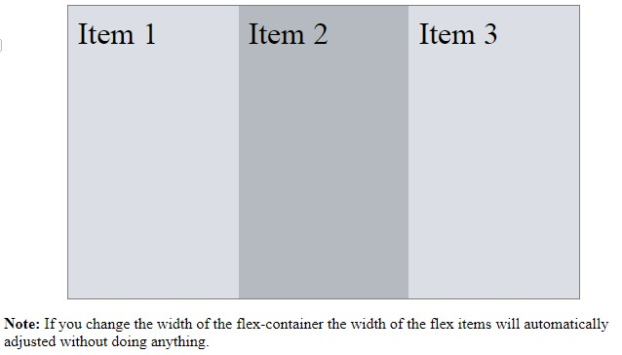
CSS Flex Layout Model
What is Flex Layout Model?
Flexible box, commonly referred to as flexbox, is a new layout model introduced in CSS3 for creating the flexible user interface design with multiple rows and columns without using the percentage or fixed length values. The CSS3 flex layout model provides a simple and powerful mechanism for handling the distributing of space and alignment of content automatically through stylesheet without interfering the actual markup.

Slide 34
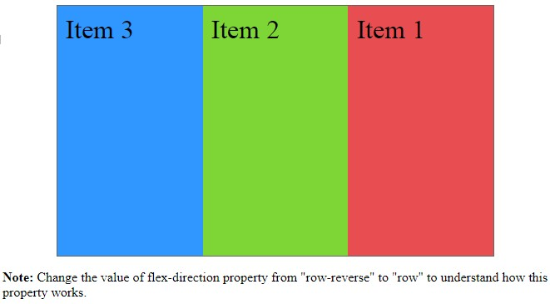
CSS Flex Layout Model
Controlling Flow inside Flex Container
In the standard CSS box model, the elements normally displayed in the order as they appear in the underlying HTML markup. Flex layout lets you control the direction of the flow inside a flex container in such a way that the elements can be laid out in any flow direction leftwards, rightwards, downwards, or even upwards.

Slide 35
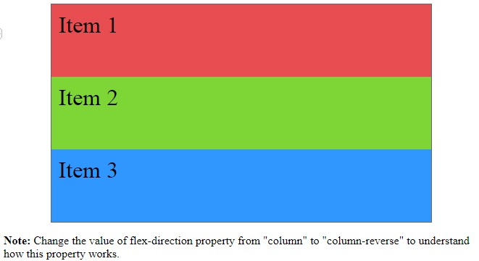
CSS Flex Layout Model
Controlling Flow inside Flex Container
you can display the flex items inside a flex container in columns instead of row using the value column for the flex-direction property.

Slide 36
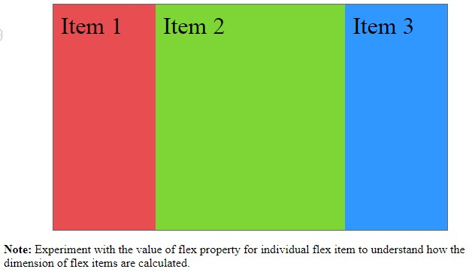
CSS Flex Layout Model
Controlling the Dimensions of Flex Items
The most important aspect of the flex layout is the ability of flex items to alter their width or height to fill the available space. This is achieved with the flex property. It is shorthand property for flex-grow, flex-shrink and flex-basis properties.

Slide 37
CSS Flex Layout Model
Aligning Flex Items within Flex Container
There are four properties justify-content, align-content, align-items and align-self which are designed to control the alignment of flex items within flex container.
The justify-content property accepts the following values:
flex-start — Default value. Flex items are placed at the start of the main axis.
flex-end — Flex items are placed at the end of the main axis.
center — Flex items are placed at the center of the main axis with equal amounts of free space at both ends. If the leftover free-space is negative i.e. if the items overflow, then the flex items will overflow equally in both directions.
space-between — Flex items are distributed evenly along the main axis, where the first item placed at the main-start edge and the last one placed at the main-end. If items overflow or there's only one item, this value is equal to flex-start.
space-around — Flex items are distributed evenly with half-size spaces on either end. If they overflow or there's only one item, this value is identical to center.

Slide 38
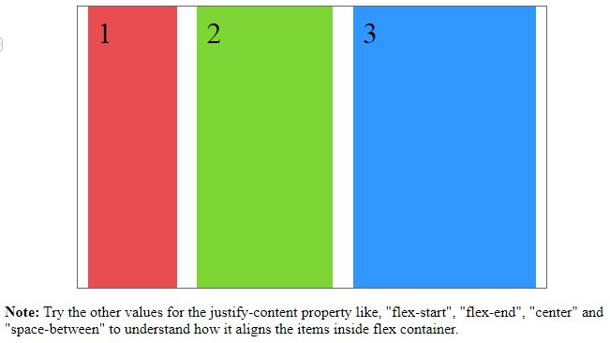
CSS Flex Layout Model
Aligning Flex Items within Flex Container
Justify-Content

Slide 39
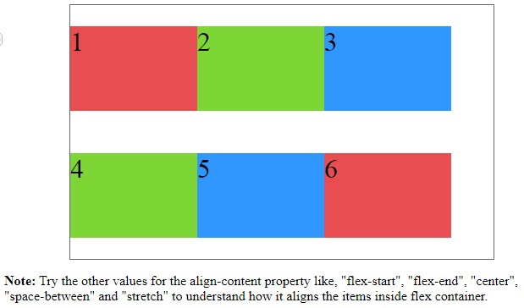
CSS Flex Layout Model
Aligning Flex Items within Flex Container
The align-content property accepts the same values as justify-content, but applies them to the cross axis rather than the main axis. It also accepts one more value:

Slide 40
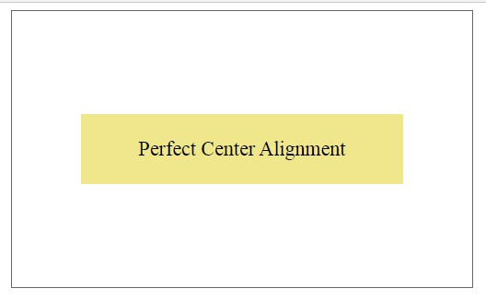
CSS Flex Layout Model
Horizontal and Vertical Center Alignment with Flexbox

Slide 41
CSS Flex Layout Model
Enable Wrapping of Flex Items
By default, flex containers display only a single row or column of flex items. However, you can use the flex-wrap property on the flex container to control whether its flex items will wrap into multiple lines or not, if there is not sufficient space for them on one flex line.
The flex-wrap property accept the following values:
nowrap — Default value. The flex items are placed in a single line. It may cause overflow, if there is not enough space on the flex line.
wrap — The flex container breaks its flex items across multiple lines, similar to how text is broken onto a new line when it is too wide to fit on the current line.
wrap-reverse — The flex items will wrap, if necessary, but in reverse order i.e. the cross-start and cross-end directions are swapped.

Slide 42
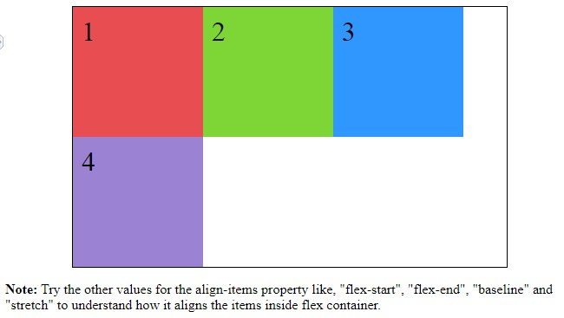
CSS Flex Layout Model
Enable Wrapping of Flex Items

Slide 43
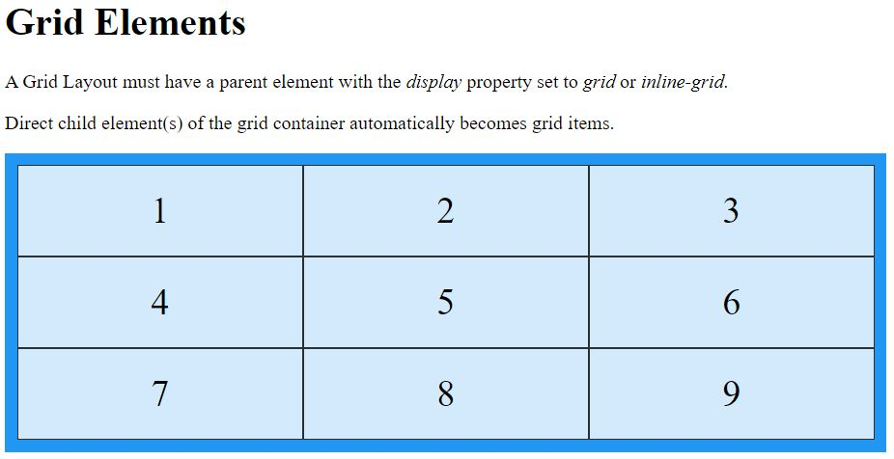
CSS Grid Layout Model
The CSS Grid Layout Module offers a grid-based layout system, with rows and columns, making it easier to design web pages without having to use floats and positioning.
Grid Elements:
A grid layout consists of a parent element, with one or more child elements.

Slide 44
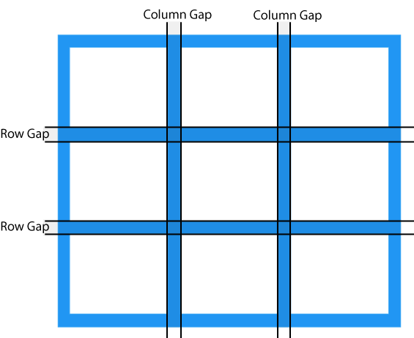
CSS Grid Layout Model
Grid Gaps
The spaces between each column/row are called gaps.
You can adjust the gap size by using one of the following properties:
column-gap
row-gap
gap

Slide 45
HTML [HYPER TEXT MARKUP LANGUAGE]
HTML Introduction
HTML Basics Tags
HTML Environment Setup
HTML Paragraph / Headings
HTML Images
HTML Lists
HTML Forms
HTML Tables
HTML Div Elements
HTML Block Elements
HTML Inline Elements

Slide 46
CSS 3 [CASECADING STYLE SHEET]
CSS Introduction & Basics
CSS Environment Setup
CSS Colors / Backgrounds
CSS Borders / Margins / Padding
CSS Text / Fonts
CSS Shadow / Positions
CSS Links
CSS Gridbox / Flexbox
CSS Forms / Buttons
CSS Responsiveness
CSS Pseudo Elements

